Slide 1

DATAMITES CDA INTERNSHIP
Customer Segmentation Analysis
Capstone Project 1
Project Team ID: PTID-CDA-MAR-23-133
PROJECT CODE : PRDA - 05

Slide 2
Our Team
Gugan K
Laxman Mallapur
Safar Dileep Kumar

Slide 3
Shopping Distribution According To Gender
In many societies, there is a prevailing trend where females tend to engage in more shopping activities compared to males. Moreover, societal norms often dictate that women place a higher emphasis on appearance and grooming compared to men
As a result, women may engage in more frequent shopping trips for clothing, cosmetics, and personal care products to adhere to these societal standards.

Slide 4
We sell more products to gender
If you're looking for statistics on consumer behavior based on gender A it's commonly reported that women tend to make more purchases than men in many product categories.
Women tend to shop more frequently than men, both online and offline. They often engage in browsing and comparison shopping, leading to more frequent purchases
Women often dominate in categories like apparel, cosmetics, household goods, and healthcare products.
Men may show higher spending in areas like electronics, automotive, and certain hobby-related items.

Slide 5
Which gender generated more revenue
Based on the provided data, it's evident that Females have contributed significantly more to the overall revenue generation compared to males.
Among the total revenue of 68,551,366, females accounted for 40,931,802, which represents approximately 59.71% of the total revenue. In contrast, males contributed 27,619,564, constituting about 40.29% of the total revenue.

Slide 6
Distribution of purchase categories relative to other columns:-
Row Labels | Count of gender | Sum of quantity | Sum of price
Books | 5K | 15K | 227K
Clothing | 34K | 104K | 31076K
Cosmetics | 15K | 45K | 1849K
Food & Beverage | 15K | 44K | 232K
Shoes | 10K | 30K | 18135K
Souvenir | 5K | 15K | 174K
Technology | 5K | 15K | 15772K
Toys | 10K | 30K | 1087K
Grand Total | 99K | 299K | 68551K

Slide 7
From the provided data, it's evident that clothing is the most dominant category in terms of quantity of purchases, followed by cosmetics and food & beverage.
Clothing: Clothing accounts for the highest quantity of purchases, with a total of 103,558 units, representing approximately 34.67% of the grand total.
Cosmetics: The cosmetics category follows clothing, with 45,465 units purchased, accounting for approximately 15.22% of the total quantity.
Food & Beverage: Food & beverage purchases amount to 44,277 units, making up approximately 14.82% of the total quantity.
Toys: Toys represent 30,321 units purchased, accounting for approximately 10.15% of the total quantity.
Shoes: The shoes category closely follows toys, with 30,217 units purchased, accounting for approximately 10.12% of the total quantity.
Technology: Technology products amount to 15,021 units purchased, representing approximately 5.03% of the total quantity.
Books: Books account for 14,982 units purchased, making up approximately 5.02% of the total quantity.
Souvenir: Souvenir purchases amount to 14,871 units, accounting for approximately 4.98% of the total quantity

Slide 8
Shopping Distribution According To Age

Slide 9
Row Labels | Books | Clothing | Cosmetics | Food & Beverage | Shoes | Souvenir | Technology | Toys | Grand Total
18-28 | 3.2K | 22.1K | 9.4K | 9.3K | 6.5K | 3.2K | 3.0K | 6.7K | 63.5K
29-39 | 3.2K | 21.6K | 9.9K | 9.7K | 6.4K | 3.2K | 3.3K | 6.3K | 63.6K
40-50 | 3.1K | 22.1K | 9.5K | 9.2K | 6.4K | 3.1K | 3.2K | 6.4K | 63.1K
51-61 | 3.1K | 21.8K | 9.8K | 9.4K | 6.2K | 3.1K | 3.1K | 6.3K | 62.8K
62-72 | 2.3K | 15.9K | 6.9K | 6.6K | 4.7K | 2.3K | 2.3K | 4.7K | 45.7K
Grand Total | 15.0K | 103.6K | 45.5K | 44.3K | 30.2K | 14.9K | 15.0K | 30.3K | 298.7K
The 29-39 age group with the highest sum of quantities indicates the members of that age group are making the most purchases across the categories 63619.
The 18-28 age group with second highest sum of quantities indicates the members of that age group are making the most purchases 63501
The 40-50 age group with the third highest sum of quantities indicates the members of that age group are making the most purchases 63058
The 51-61 Ge group with the fourth highest sum of quantities indicates the member of the age group are making the most purchases 62826
The 62-72 Ge group with the fourth highest sum of quantities indicates the member of the age group are making the most purchases 62826

Slide 10
We Sell More Products To cat Age
Based on the provided data, it appears that the 29-39 age category has the highest percentage of product sales at 21.29%closely followed by the 18-28 age category at 21.27%. The 40-50 age category follows with 21.14%, the 51-61 age category at 20.99%, and the 62-72 age category at 15.31%.
29-39 Age Category: This age group accounts for the highest percentage of product sales at 21.29%, indicating that individuals within this age range are the most active purchasers among the specified groups

Slide 11
Age Categories Generated More Revenue
Based on the provided data, it appears that the 40-50 age category generated the highest percentage of revenue at 21.36%, closely followed by the 29-39 age category at 21.26%. The 18-28 age category follows closely behind at 21.16%, while the 51-61 age category generated 20.84% of revenue. The 62-72 age category contributed 15.38% to the revenue.
The 40–50 age category generated the highest percentage of revenue at 21.36%, making it the top revenue contributing age group among the ones listed.

Slide 12
Payment Method Have A Relation With Other Columns
Row Labels | Gender | Sum of Price | Sum of quantity
Cash | 44K | 30705K | 133K
Credit Card | 35K | 24051K | 105K
Debit Card | 20K | 13795K | 60K
Grand Total | 99K | 68551K | 299K

Slide 13
Cash transactions account for the highest sales value, with a total of TRY30,705K, followed by credit card transactions at TRY 24,051K, and debit card transactions at TRY 13,795K.
In terms of the quantity of transactions, cash transactions also lead with TRY 133K transactions, followed by credit card transactions at TRY 105K, and debit card transactions at TRY 60K.
Overall, the grand total of all transactions across all payment methods is TRY 68,551K, with a total of TRY 299K transactions

Slide 14
The Distribution Of The Payment Method

Slide 15
Row Labels | Sum of price | Sum of quantity
Cash | 30705K | 133K
Credit Card | 24051K | 105K
Debit Card | 13795K | 60K
Grand Total | 68,551.4K | 298.7K
Cash transactions account for the highest sales value, with a total of 30,705K, followed by credit card transactions at 24,051K, and debit card transactions at 13,795K.
In terms of the quantity of transactions, cash transactions also lead with 133K transactions, followed by credit card transactions at 105K, and debit card transactions at 60K.
Overall, the grand total of all transactions across all payment methods is $68,551K, with a total of 299K transactions.

Slide 16
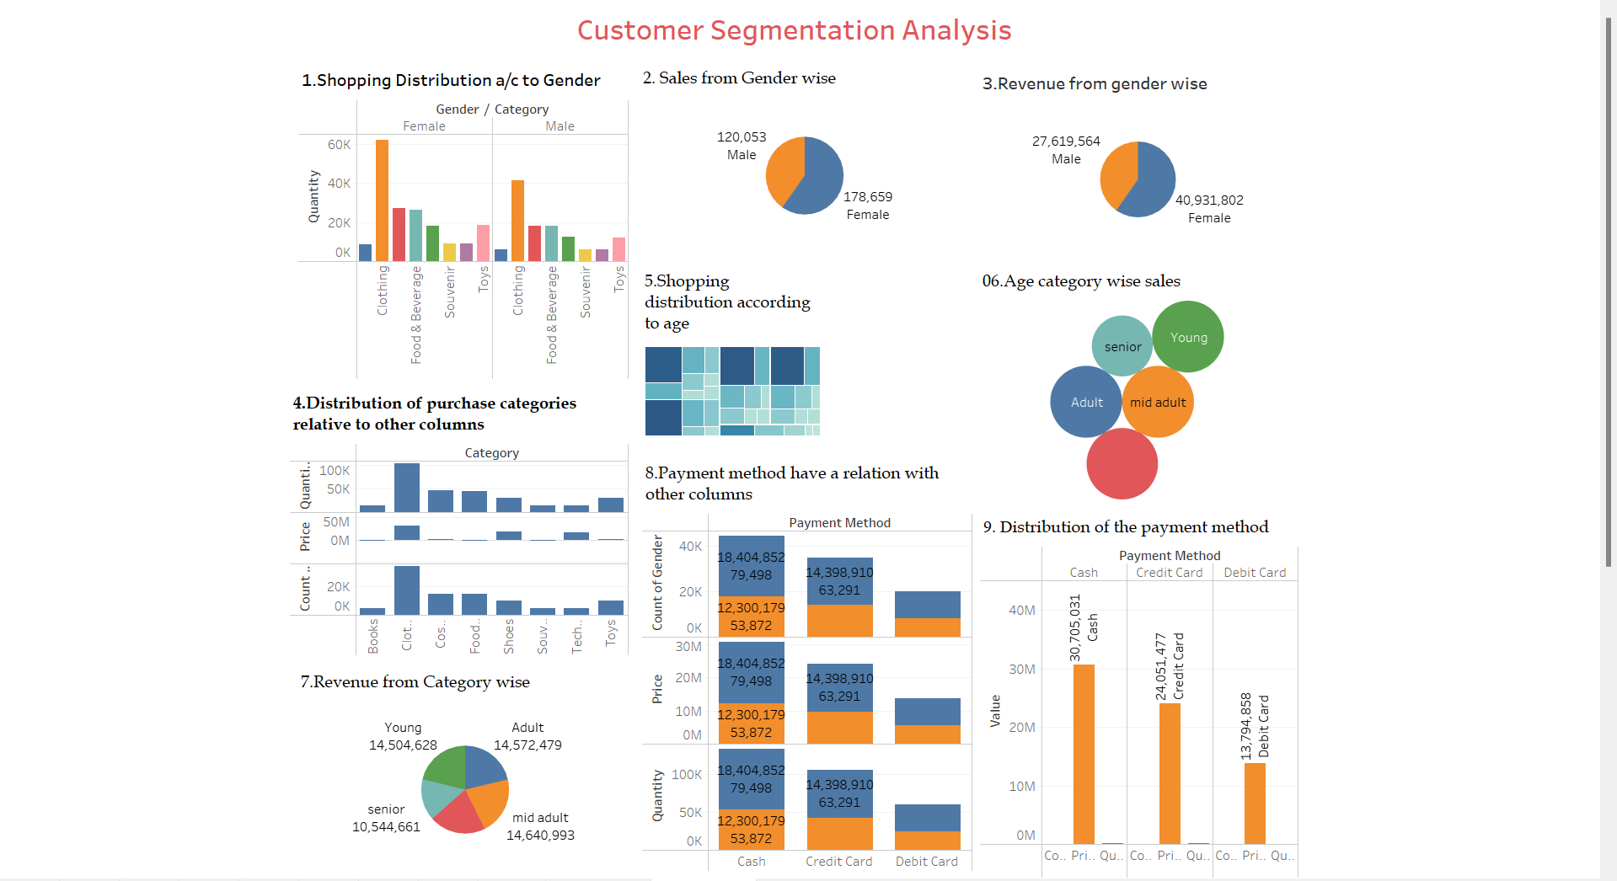
Visualize the data using Tableau

Slide 17
Suggestions To The Company
Based on your analysis that women engage in more shopping and generate more revenue compared to men, here are some suggestions you could consider:
Leverage social media platforms to engage with your female audience effectively
Explore partnerships or collaborations with female-focused brands or influencers to expand your reach and credibility within the female demographic.
Co-branded promotions or sponsored content can help increase brand visibility and attract more female customers.
Create exclusive discounts or loyalty programs for women. Reward their loyalty with special perks, early access to sales, or birthday discounts. Encourage repeat purchases by offering points or rewards for every transaction.
Engage with men on social platforms. Share content relevant to their interests . Run contests or polls to encourage participation.

Slide 18
THANK YOU

